Slide 1


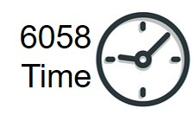





MGMT 6056 Module 3
Exercises
Do the exercise prior to next slide
Videos
Solution Slide
PPT Animations
Exercise Simulation
Cost Plan, Classifications, Overhead
M3 Pearson Pinto p137 q1-3.tif
M3 EXERCISE Student Template for Pinto p137Total Direct Labour Costs.xlsx
Optional file, to use Excel vs work done on paper
See text in “slide note” for more details

Slide 2
Module Learning Objectives
Understand how planning cost management provides guidance for managing costs throughout the project
Understand various cost classifications
Work with Fully Loaded Labour costs and overhead
Work with unit costs and breakeven points
Work with 3-point estimates, PERT, and Statistical Cost Estimation including probabilities

Slide 3

“Money often costs too much” ― Ralph Waldo Emerson
Notes:
Retrieved from www.pexels.com, All photos on Pexels are free for any personal and commercial purpose

Slide 4
MGMT 6056 Module 3
Part 1
Plan Cost Management

Slide 5
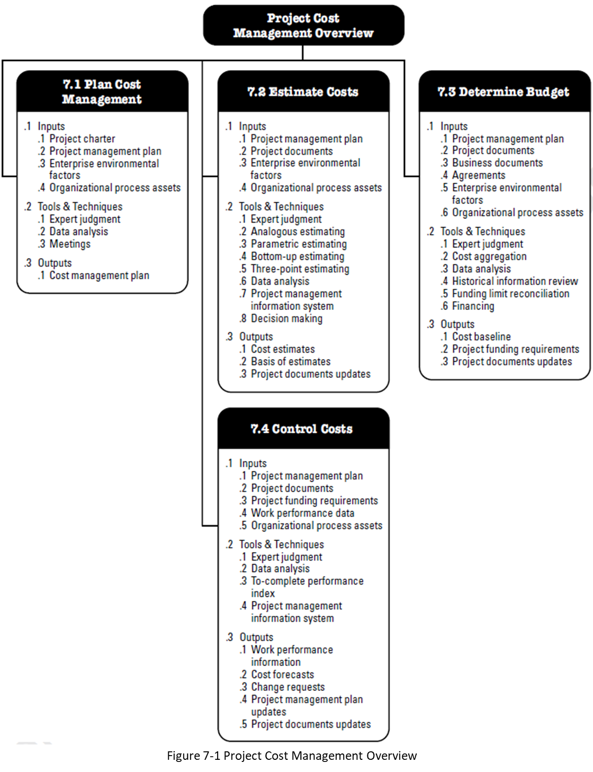
Plan Cost Management – The Plan
Cost Management Plan, the overall plan or guidance for the Cost Management Knowledge Area
E.g., what currency will we be using for the project?
Source: PMBOK 6th Edition, 2017
Notes:
Most of the Knowledge Areas in PMBOK start with a planning process focused on the specific knowledge area. We need to make decisions on how we’re going to approach the specific Knowledge Area for a specific project. For example for Project A we may use CAD$’s and for Project B USD$’s, but for Project A we just use Excel for Schedule Management but MS Project for Project B.

Slide 6
The Cost Management Plan can establish the following
Units of measure: Units for labour (hours, days, weeks), how many hours in a work day / week, metric or Imperial for quantity measure, currency.
Level of precision: Degree to which activity cost estimates will be rounded up or down (e.g.. CAD$100.49 to CAD$100, or CAD $995.59 to $1000)
Level of accuracy: The acceptable range used in determining realistic cost estimates (e.g., +/-10%)
Organizational procedure links: How the WBS will be linked to control accounts
Precision vs Accuracy?
Notes:
In everyday language we sometimes use precision and accuracy interchangeably but they are not the same.
Precision indicates how precise the number is that was written or displayed. 27.36 is more precise than 27.4 which is more precise than 27.
But accuracy is an indication of the likelihood of the number written or displayed. If you were stand 10 metres away from a chair and you estimated the back of the chair to be 117.258 cm high, it does NOT mean the accuracy of your guess is to within 1/1000 of a cm. More likely, your accuracy is probably plus or minus, say 15% of your guess. But your precision was to 1/1000 of a cm.

Slide 7
The Cost Management Plan can establish the following (cont’d)
Control thresholds: What agreed upon threshold indicates action needs to be taken (e.g. +/- 10% of budget)
Rules of performance measurement: Level in the WBS which measurement of control accounts will be performed, measurement techniques used (weighted milestones, fixed-formula, percent complete), specify EVM equations for calculating EACs
Reporting formats: format and frequency for the various cost reports
Process descriptions: Cost management processes are documented
Additional details: strategic funding choices, dealing with currency exchange rates, procedure for project cost recording

Slide 8
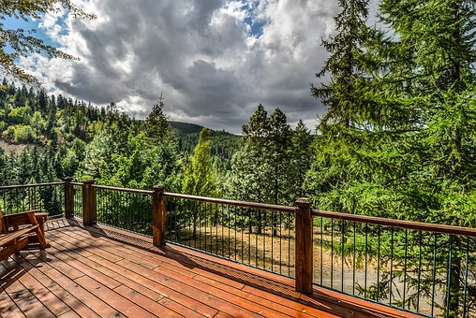
A Cost Management Plan for Deck Alpha
Units of Measure:
Level of precision:
Level of accuracy:
Organizational procedure links:
Control thresholds:
Rules of Performance Measurement:
Reporting Formats:
Process Descriptions:
Additional Details:
Come up with some examples for a few of these areas for a backyard deck …

Slide 9
Cost Management Plan for a Deck
Units of Measure: All labour will be estimated and reported in hours. 8 labour hours in day, 40 labour hours in a week. Imperial measurement system will be used for quantity measures, currency used in Canadian dollars.
Level of precision: Cost estimates will be to the nearest CAD $0.01
Level of accuracy: Preliminary cost estimates will be accurate to +/-10%, final estimates +/-3%,
Control thresholds: A variance of +/- 10% or minimum $100 per control account will cause for action to be taken
Precision vs Accuracy? We are going to record our numbers to the nearest cent (our precision) but even our final estimate is only +/- 3%. So we might have a final estimate of $100.00 for an activity but the +/- 3% indicates we think it’s between $97.00 and $103.00

Slide 10
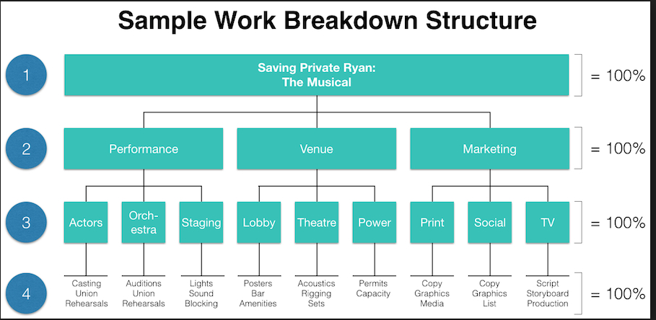
Cost Management Plan for a Deck
Organizational procedure links: Both 2nd and 3rd level WBS Elements (based on the cost of the element for example) will be assigned control accounts linking directly to the accounting system. Control accounts are the accounts in the WBS where we are capturing ongoing expenditures in our project.
We may want to have control accounts at level 2 (Major Deliverable) for Venue, but at the WP level for Performance

Slide 11
Cost Management Plan for Deck (cont’d)
Rules of Performance Measurement: Measurement will occur at the second level of the WBS, percent complete will be used for EVMS.
Reporting Formats: EVMS report will be provided weekly showing budget, actuals spent, Cost Variances and Cost Performances Indexes per Cost Account.
Process Descriptions: All work package Activities will be estimated using a bottoms up method using estimates from experts, commercial databases, available industry information and are to include contingencies.
Additional Details: Project will be funded through customers down payment and company’s line of credit. All sourcing is done in Canada therefore currency exchange is not an issue. Project cost recording will be done through use of work order numbers for each control account being used on all invoices and labour hours being submitted per work order using company timekeeping system.

Slide 12
Part 2
Cost Estimation and Budgeting

Slide 13
Cost Management Terms
Cost Management can include:
Data collection
Cost estimation processes create a reasonable budget baseline for the project.
Budgeting, creation of a budget based on estimates
Cost accounting and cost control which serve as the chief mechanisms for identifying and maintaining control over project costs.
Cost Estimation: How can we figure out how much a project would cost?

Slide 14
What are some of the cost categories and cost items on a new cruise ship of this size?
Writing on a scrap of paper, whiteboard, document:
Brainstorm 10 major categories of costs.
Did you observe Operations vs Project elements in the videos?
What are 3 of the most expensive individual cost items you can think of from the video?
Come up with a “guesstimate” for how much you think this type of ship would cost, best guess?
Notes:
To get an approximation of costs, see both #1 Oasis of the Seas and #2 Allure of the Seas
https://www.boaterexam.com/blog/2011/03/most-extravagant-cruise-ships.aspx

Slide 15
Why do we need a formal approach to figure out the costs for a project?
How many cost items could possibly be in a project?
How large could a WBS be?
Oasis of the Seas: The Biggest Cruise Ship in the World
https://www.youtube.com/watch/RgV4Q_So_dg 1:59
Harmony of the Seas : The construction of the biggest cruise ship
https://www.youtube.com/watch/MjaBlBb1nUQ 2:25

Slide 16
Common Sources of Project Cost
There are many sources depending on the project but here are some common elements:
Labour
Materials
Subcontractors
Equipment & facilities
Travel and expenses
We’ll go through these in more detail

Slide 17
Labour Costs
Costs associated with hiring and paying the various personnel involved in developing the project
Different classification of workers with different rates (skilled, semi-skilled, labourers etc.)
Must consider all employees – salary and hourly
Must consider benefits in hourly rates – pension and health.
Need to estimates workers’ exposure to the project in terms of hours
Example of labour for a Cruise Ship?
Notes:
From the videos, you can see a lot of steel being used, so Welders would represent one of many labour cost categories.

Slide 18
For a Cruise Ship?
Materials
What material is needed to complete the project tasks
Material could be wood, siding, insulation, paint etc. for building projects.
Material could be a software package for IT project.
Some materials are considered overhead.
Subcontractors
Subcontractors costs must be reflected in budget
Subcontractors could provide marketing services, design services, construction services etc.
Notes:
In addition to steel, glass/windows is another significant material cost item. On a cruise ship there would be thousands of material cost items.

Slide 19
Equipment and facilities
May need to rent office space, tools, equipment, warehouse for project.
Travel and Expenses
Personnel may need to travel to clients for project meetings or provide services.
Will need to charge for car rentals, airfare, hotels, meals and any other expenses related to project.

Slide 20
Types of Costs
We have a lot of different costs and types of costs, we need to classify them, to track them, promote accurate communication, and avoid confusion
Direct Vs. Indirect
Recurring Vs. Nonrecurring
Fixed Vs. Variable
Normal Vs. Expedited
We’ll go through these in more detail

Slide 21
Direct Costs
Direct costs are those clearly assigned to the project.
Direct cost examples are labour and materials directly used on a project vs. across multiple projects
Formula for determining total direct labour costs:
Total direct labour costs = direct labour rate X total labour hours paid to staff -- not the hours billed to the customer (billable hours) which might be less. See slides below using “billable hours”.
Direct Material Costs are materials used exclusively for a specific project
Note, material costs could be tracked/calculated by totaling all Purchase Orders (Purchases) associated with the project

Slide 22
Indirect Costs
Generally, indirect costs cannot be attributed solely to a single project.
There are 2 major categories of indirect costs:
Overhead: utilities, taxes, insurance, property and repairs, depreciation, health and retirement benefits
Selling and General Administration: Advertising, shipping, salaries, sale and secretarial support
Some organizations may charge a flat rate for overhead (20-50%) on top of direct costs. Generally overhead costs are indirect costs.
Other organizations allocate indirect costs project by project based on analysis and calculations.

Slide 23
Recurring Versus Nonrecurring Costs
Recurring costs are those that continue to operate over the project’s life cycle.
Recurring costs examples are labour, material, logistics, sales costs.
Nonrecurring costs can be associated with charges applied once at the beginning or end of the project.
Nonrecurring cost examples include one-time training or marketing research costs
Your cell phone bill?
Notes:
If you bought your cell phone outright from a telecom provider you could have requested 2 types of invoices. One for the purchase of the phone (nonrecurring) and then monthly recurring invoices for your use of the providers cell network.

Slide 24
Fixed Versus Variable Costs
Fixed costs do not vary with usage. For example, rent for an apartment doe not vary regardless of how much days in the month you were actually there.
Variable Costs accelerate or increase through usage. On some cell phone plans, you may have to pay more for data if you use more data.

Slide 25
Normal Versus Expedited Costs
Normal Costs refer to those incurred in the routine process of working to complete the project according to the original, planned schedule.
Expedited Costs are unplanned costs incurred when steps are taken to speed up the project’s completion. May include overtime, hiring additional staff, hiring subcontractors, higher transportation costs. A simple example would be when you select next day delivery rather than 5 day delivery. You are expediting the shipment.

Slide 26
Cost Classifications
Common Cost Term – Sunk Cost
The cost you have incurred that may or may not have provided value. Either way you cannot get the money back, it is a “sunk” cost.
Non-recurring
Recurring
Variable
Expedited
Indirect
Normal
Direct
Fixed
Costs
Direct labour | X |  | X |  |  | X | X
Building Lease |  | X | X |  | X |  | X
Expedite | X |  |  | X |  | X |  | X
Material | X |  | X |  |  | X | X

Slide 27
Labour Costs – Frequently “Fully Loaded Hourly Rates” are used to include overhead and other considerations
Role | Basic Hourly Rate | X | Overhead Factor (% overhead or a factor) | X | Personal Time Factor (PTF) | = | Fully Loaded Hourly Rate
Supervisor
Labourer 1
Labourer 2
Role | Fully Loaded Hourly Rate | X | Hours Role works on project | = | Total Direct Labour Cost
Supervisor
Labourer 1
Labourer 2
 |  |  |  |  | Sum the labour cost roles for the project total
Sources for salaries and overhead:
http://www.livingin-canada.com/salaries-for-carpenters-canada.html
http://www.wahby.com/articles/overhead_defined.htm

Slide 28
Fully Loaded Hourly Rate - Example
Title | Hourly Rate | Overhead Charge Factor (percent overhead) | Personal Time Rate Factor (PTF) | Fully Loaded Hourly Rate
Supervisor | $40/hr | 1.5 (50% overhead) | 1.2
40 x 1.5 x 1.2 = |  |  |  | $72/hr
An example of a 20% PTF. Supervisor is paid for 8 hours a day (9am to 5pm), but allowed half an hour for lunch, two 15 minute breaks and used 20 minutes for phone calls. Total minutes not working on the project in the 8 hours = 30 + (2 x 15) +20 = 80 minutes or 1.3333 hours. 8 -1.3333 = 6.6666 hours. 8/6.6666 = 1.2 for the PTF See the next slide for another detailed PTF example.
Title | Fully Loaded Hourly Rate | Hours Required for the project | Total Direct Labour Cost
Supervisor | $72/hr | 100 hours | $7,200
72 x 100 = |  |  | $7,200

Slide 29
Personal Time Factor – Billable Hours “Personal Scenario”
Working with a previous client, you were paid $20/hr, or $160 for being at the client’s office 8 hours each day (8am to 12 noon and 1pm to 5pm).
What would you do if a new client said $160 for the hours worked above is fine.
But they say you are paid based on the exact times you enter into their time-tracking web app -- and you can only enter, (and are paid on) time spent on the project, not breaks, nor personal calls/texts. You want to make $160, so what do you say?
Actual hours spent at new client’s office, 8 hrs.
You estimate non-project time as follows:
Two 15- minute Coffee Break 0.5 hours
Bio Breaks 0.2 hours
Personal Calls/Texting 0.25 hours
Total non-project time 0.95 hrs
Daily average project related time you would enter into the app would be 8 hrs – 0.95 hrs = 7.05 hrs. This is sometimes called billable hrs, vs the actual hrs spent at the client’s office. Personal Time Factor (PTF) = 8 hr/7.05 hr = 1.135.
You could say you’d work for $22.70/hr ($20 x 1.135) and would enter on average 7.05 billable hrs in the app each day. 7.05 hrs x $22.70/hr = $160.04 ~ $160

Slide 30
A Different Time Factor – Using Billable Hours “Consulting Firm Scenario”
A consulting firm is estimating the costs (excluding overhead, excluding profit) for a client project. The firm knows the client only pays outside consultants 7.5 hrs per day (billable hours). This is just the client’s policy, it may or may not have anything to do with personal time such as breaks. Perhaps employees at the client’s office are supposed to be at work 7.5 hours a day, so outside consultants can only bill 7.5 hours a day.
The firm wants to estimate their project costs using billable hours, but they also know they have to pay their consultants for 8 hours a day.
The firm pays their consultants $40/hour but what is the hourly cost using billable hours?
Actual hours consultants will be paid daily by the employer, 8 hours. Daily billable hours is 7.5 hours. Time Factor (TF) = 8 hrs/7.5 hrs = 1.0666.
So the labour cost for the firm’s consultants based on the billable hours with this client is $40/hr X TF = $40/hr X 1.0666 = $42.67/hr.
So if the firm estimated there were 80 billable days required for the project, their cost of their consultants would be 80 X 7.5 = 600 hrs. 600 hrs X $42.67/hr = $25,602. This is about the same as 80 days X 8 hrs/day X $40 = $25,600.

Slide 31
Exercise on Labour Rates
Using the M3 .tif file below found on FOL for this module, answer the questions using calculator and paper
Assume a 40 hour work week for question 3.
M3 Pearson Pinto p137 q1-3.tif
And as an option you can use this file below with Excel rather than paper
M3 EXERCISE Student Template for Pinto p137Total Direct Labour Costs.xlsx

Slide 32
Questions 1,2,3 on page 137 in custom text, page 269 in full text
Q1 $35 X 1.55 = $54.25/hr X 150hrs = $8,137.50
Q2 total dir labour costs is the sum of below: Sandy $1,632.96 Chuck $4,860.80 Bob $972.00 Penny $2,352.00 Total is $9,817.76
Q3 200 hrs/40 hrs per week = 5 weeks Overhead is 5 wks X $150/wk or $750 Regular rate is 200 hrs at $10.50/hr = $2,100 Total is $2,850

Slide 33
Unit Costs
Calculating costs per unit typically for material or expenses
A fully loaded rate is a form of a unit cost
Can be an average or approximation
Unit Cost = Variable Costs per unit + Fixed Costs / Total Units Produced.
Example: commercial filters are $40 each, but we have to buy at least a box of them, which has 12 filters. And it costs $48 to have the box delivered Unit cost per filter = $40 + $48/12 = $40 + $4 = $44
Unit cost per filter = $40*12 +$48 = $528 $528/12 = $44
Unit cost is useful for material estimating, it can be applied to dozens of activities that require the material.

Slide 34
Unit Costs – Based on Fixed and Variable Costs
Widget Exercise, Variable Cost is $50 of material per widget, $100 to rent a machine and we can make the units. But you can buy a pre-made widget for $80.
$
How many widgets would you have to make in order for it to be cheaper to make them rather than buy them?
Cost to rent machine
Cost material for one unit
Notes:
You are making widgets, and it cost $100 to rent the widget making machine, and $50 of material for each widget you make.
You can buy a pre-made widget for $80. How many widgets would you have to make in order for it to be cheaper to make them rather than buy them?
Solution 1
From the graph with Trial and Error:
At 3 units, the total cost is $250. $250/3 = $83.33 per unit which is greater than $80
At 4 units, the total cost is $300. $300/4 = $75 per unit which is less than $80
Solution 2
Or we can solve for “?units” where ?units represents the number of units we could make that would equal the price to buy them:
Fixed Cost/# of Units + Variable Cost per unit = Unit Cost [This formula is the same as the previous slide]
($100/?units +$50 = $80 (the price we can buy them)
100/?units = 30
100/30 = ?units
3.33 = ?units
But we can only have discrete units, not fractions. 3 units would be more expensive to make than buy, but at 4 units it would be cheaper.
Solution 3
Or we can solve for “?units” where ?units represents the number of units we could make that would equal the price to buy them:
Slightly different and longer formula - Total Cost/Number of Units = Unit Cost
(Fixed Cost + Variable Cost per unit X Number of Units)/ Number of Units = Unit Cost
($100 +$50 X ?units)/?units = $80 (the price we can buy them)
100 + 50?units = 80?units
$100 = 30?units
3.33 = ?units
But we can only discrete units, not fractions. 3 units would be more expensive to make than buy, but at 4 units it would be cheaper.

Slide 35
Unit Costs and Breakeven Point
Widget Example, Variable Cost is $50 of material per widget, $100 to rent a machine and we can make the units. But you can buy a pre-made widget for $80.
$
We can also see this which is less expensive graphically
This is called the “breakeven” point
Notes:
This is a typical “breakeven” scenario. If we want just one of something, it’s cheaper to buy it. But if we want many, it could be cheaper to make them ourselves.
In this case, at 3 units it’s cheaper to purchase the units, the orange line, but at 4 units it’s cheaper to make, the green line.

Slide 36
This section is similar in 6056 & 6058
Part 3
3-point estimates, PERT, and Statistical Cost Estimation including probabilities

Slide 37
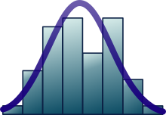
Standard Deviation Calculator
Use this webpage to create the Standard Deviation for a set of data. Enter 10 positive numbers in the light green box that represent time (in minutes) for the last 10 times it took you (you can guess) to travel to your college (or work). Use the “Sample” radio button. https://www.mathsisfun.com/data/standard-deviation-calculator.html
Follow the calculations, the turquoise area is the mean or average.
Examine the chart noting your data points, the mean, and -1SD and +1SD (SD is Standard Deviation)
SD’s are used to create “ranges” e.g. a mean of 40 min +/- an SD of 6 min is a range from 34 to 46 min.
Ignore the formulas at the bottom of the page.

Slide 38
Normal Distribution
Work your way through this webpage but STOP before “Why Standarize …?” https://www.mathsisfun.com/data/standard-normal-distribution.html
Try the business problem: We want to tell a customer a range for the time it will take to perform a project, the “project duration”. We want to be 95% certain of our answer. We have done this type of project many times before so we know on average it takes 45 days and the SD (Standard Deviation) is 5.5 days. Rather than just saying 45 days, what is the range we would tell the customer?
Notes:
From the website we know if we use 2 SD’s on either side of the mean, we know 95% of the time the project duration will be between +/- 2 SD’s.
So we take our mean and subtract 2 SD’s , and add 2SD’s.
- 2 SD’s 45 – 2 x 5.5 = 45 -11 = 34
+ 2 SD’s 45 + 2 x 5.5 = 45 +11 = 56
So the range is 34 to 55 days, and we are 95% certain the project duration will be in this range.

Slide 39
Duration and Cost Estimation Probability
For 6056 Cost, we are estimating costs ($’s) but for 6058 Time, we are estimating durations!
Estimates are based on normal working methods during normal business hours. But realistically estimates should be a range of numbers representing probabilities and based on:
Research
Past experience
Expert opinion
Mathematical derivation, for example:
Most likely (m)
Most pessimistic (b) sometimes called “p”
Most optimistic (a) sometimes called “o”

Slide 40
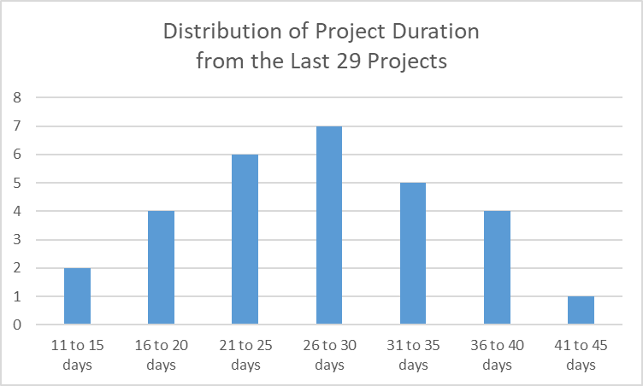
Duration and Cost Estimation Probability
In this chart, we have graphed the duration of the last 29 projects we did. They were quite similar, but note we have a wide range of durations. While we would most likely get a new project done in 26 to 30 days (our Mode), it could take between 41 to 45 days, or possibly 11 to 15 days.
Although this diagram indicates duration (time) a similar story could be graphed for the cost of projects.

Slide 41
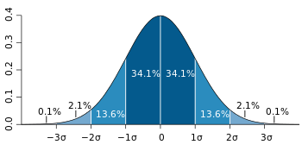
Given Sigma, we can use 1, 2, and 3 Sigma’s (the 68–95–99.7 rule). E.g. if the average cost for a pump was $1.8k and sigma was $0.2k, 34.1% of the cost estimates are between $1.6k and $1.8k, or about 68% are between $1.6k and $2.0k
Statistics and Estimation Normal Probability Distribution
What is a standard deviation? Also called “sd”, sigma, or σ. It provides an indication of the width or range of the distribution.
Source: https://en.wikipedia.org/wiki/Standard_deviation
~ 68%
Sigma $0.2k
$1.6k $1.8k $2.0k

Slide 42
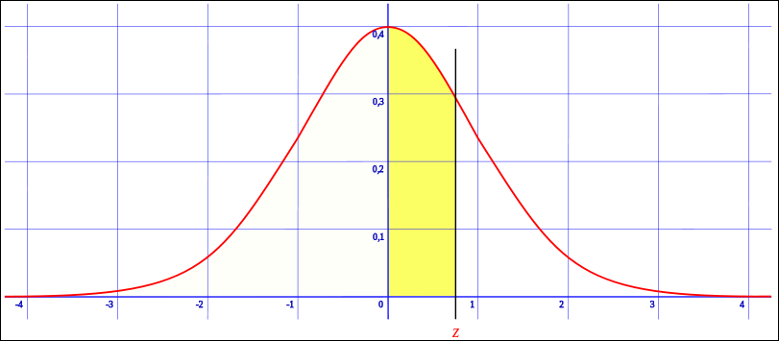
Statistics – Normal Probability Distribution is based on Standard Deviations
We can use tables, online calculators or Excel to determine probabilities for specific sigma’s
Z on the horizontal axis represents the number of standard deviations
https://en.wikipedia.org/wiki/File:Z_cumulative_from_mean.svg
https://www.mathsisfun.com/data/standard-normal-distribution-table.html
This link is a great interactive tool to experiment with the concept of standard deviation, Z, and probabilities. Change the radio buttons for Z, and compare your results on the interactive graphic, with the tables below it (scroll down). For example, use +1.0 Z in the interactive graphic in the link and change the radio buttons in the graphic to see if you can view the same probability number between the interactive graphic, and the tables below the graphic.

Slide 43
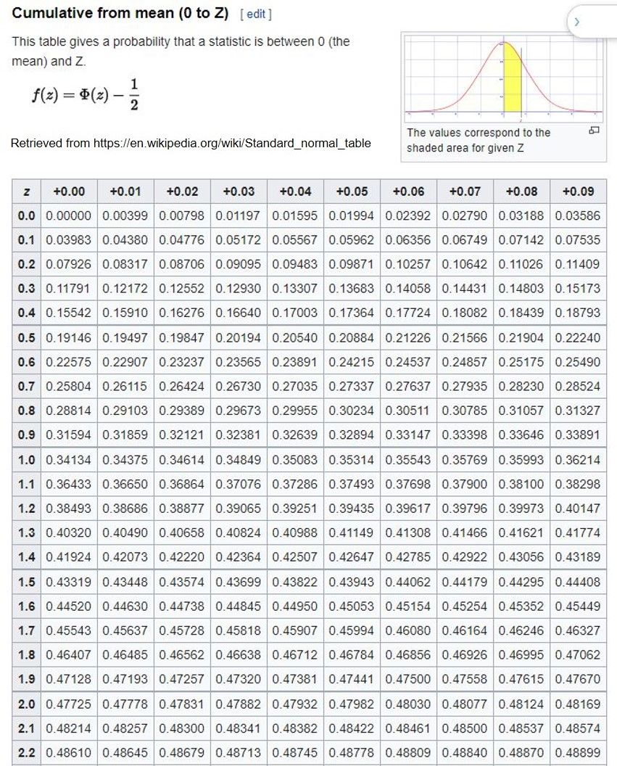
Probability Distribution
Note the key for the Z Table
We can use this Z table to determine the probability of a cost for an Activity, but we need to know:
Estimated Cost
Cost standard deviation
What is the specific cost we are interested in
Z, via a calculation
And then we can use the Z table to determine the probability of the specific cost

Slide 44
Exercise Project Gamma-Cost Probability Distribution
Note the key for the Z Table
Q1: If we had an estimated cost of $50K, a sigma of $20K, and we wanted to know the probability of the project costing less than $65K what would the probability be?
Q2: What if we wanted to know the probability of the project costing less than $40K, what would the probability be?

Slide 45
Answers
Q1
Z represents the number of standard deviations we are interested in, which would be (65-50)/20 or 15/20 or 0.75 standard deviations. Using the table, 0.75 equals 0.27337 or 27.3% probability.
But, per the yellow area of the key at the top right, 27.34% represents the probability between $50K and $65K. We want to know less than $65K.
All of the area under the curve is 100% of the probability, so the left side of the picture is 50%. We add the left side with the yellow area to get 50% + 27.34% = 77.34%.
You can double check your Z table lookup 2 ways, use the link https://www.mathsisfun.com/data/standard-normal-distribution-table.html and use the radio button setting at the top left “Up to Z”, or … you can use the Excel formula =NORM.DIST(65,50,20,TRUE)
Q2
This is a bit trickier given the limitations of our table.
Z represents the number of standard deviations we are interested in, which would be (40-50)/20 or -10/20 or -0.5 standard deviations. Using the table, 0.5 equals 0.19146 or 19.15% probability.
We are saying there is a 19.15% probability of the Activity Cost being between $40K and $50K.
Using the left side of the table is 50% probability, we can say there is 50% probability of the Activity being less than $50K.
And if there is a 19.15% probability of the Activity Cost being between $40K and $50K we can say there is 50% - 19.15%, or a 30.85% of the Activity Cost being under $40K.
You can double check your Z table lookup 2 ways, use the link https://www.mathsisfun.com/data/standard-normal-distribution-table.html and use the radio button setting at the top left “Up to Z”, or … you can use the Excel formula =NORM.DIST(40,50,20,TRUE)

Slide 46
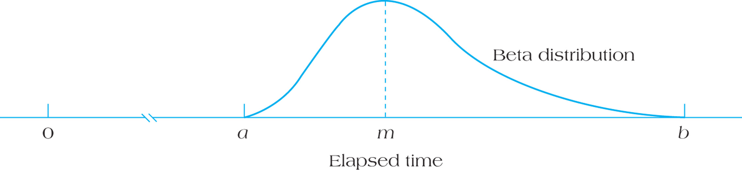
Asymmetrical (skewed or Beta) Distribution
See this link for a YouTube example of a normal distribution and a skewed distribution 3:23 min, good summary at 3:10 in video
https://www.youtube.com/watch/XSSRrVMOqlQ
Skewed estimates are typically more realistic for duration and cost estimates, but it’s simpler to use a normal distribution
Why is an asymmetrical estimate more realistic than a symmetrical one for costs or durations?
Most
Likely
Optimistic
Pessimistic
FIGURE 9.15 Asymmetrical (Beta) Distribution for Activity Duration Estimation
Notes:
When things go wrong they can go really wrong. For example something that might take 6 days normally (ML or most likely), might take 12 days when everything goes wrong (rare but it happens). The difference between the P and ML is 12 – 6 = 6 days. If the curve was symmetrical, that means the Optimistic O would also be 6 days from ML. So O would be ML – 6 or 6 – 6 = 0 days. Realistically, if everything went absolutely perfect we might expect O to be 2 or 3 days, but not zero days.

Slide 47
Activity Durations and Variances
Are O and P symmetrical around “Likely” very realistic?
Table 9.2
Notes:
Although we use symmetrical normal distribution curves, sometimes called Bell Curves, in reality distributions for costs and durations of activities or projects are frequently asymmetrical. So if you look at Activity B, the difference between O and ML (Most Likely) is 3 weeks, but so is the difference between ML and P. So B is presented as a symmetrical Activity. This is very common as it keeps things simple. We might say for Task B, it’s 5 weeks long plus or minus 3 weeks, but in reality in might be 3 to 9 weeks with ML being 5.

Slide 48
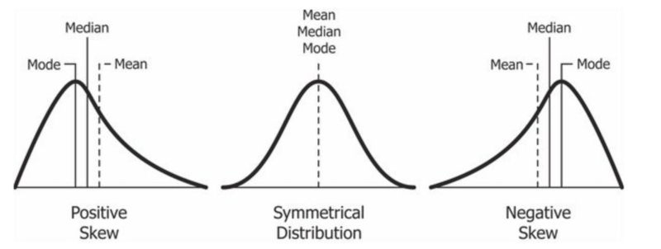
Positive Skew and Central Tendency
In most cases in project management, we have a positive skew. Things might finish a little bit quicker or cheaper – but there’s a very good chance it could take a lot longer and require a lot more money.
Retrieved from https://en.wikipedia.org/wiki/Skewness
In statistics, the most common measures of Central Tendency are the mean (average), the median (half of the data is on either side), and the mode (the most frequent value or the peak of the data).

Slide 49
3-Point Estimate (TE) Formulas
Typically Activity duration (and cost) estimates are skewed curves, and frequently we don’t have historical data so we might have our experts estimate using 3 points - Optimistic, Most Likely, Pessimistic (O, M, P).
We use two types of 3-point estimating formulas to derive our estimate called TE.
Triangular estimate, a simple average (a+m+b)/3
PERT Method of duration estimate which is a weighted average, and produces a more practical estimate (closer to the median) for skewed distributions.
What if O, M, and P were 2, 3 and 10? Triangular vs PERT? What would be the differences in the estimates.?
Notes:
Using P for pessimistic (b), and O for optimistic (a) and ML for most likely (m) also called ML.
Triangular Distribution: (P + O + ML) / 3.
(2+3+10)/3= 15/3 = 5
PERT Distribution (P + O + 4ML ) / 6 Note in this formula ML is weighted 4 times as much as O or P in the formula.
(2+4*3 + 10)/6 = 24/6 = 4

Slide 50
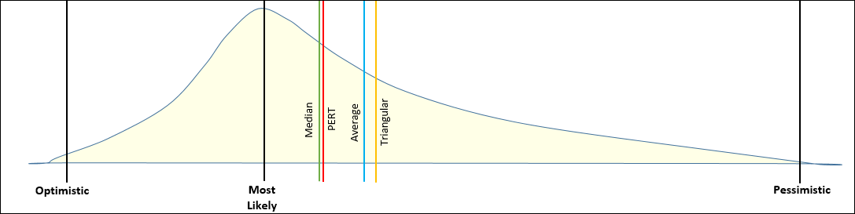
Comparison of Skewed Distribution Measurements
Median & Average – we need a historical data set
PERT & Triangular – we can use O,M,P from expert opinions
One of the reasons a PERT estimate is used for a duration is that it typically is the closest to the Median, which represents the point at which 50% of the probability is less than the median and 50% more. If we only have O, M and P estimates we cannot calculate the Median, but we can calculate a PERT estimate which is close to the Median. And we can’t calculate the real Average with O, M, P, only a 3-point triangular average. But either way, what does an “average” really tell us in a skewed distribution?
Notes:
We need a set of data to calculate the Average (Mean) and the Median. And if we’ve done the same activity 20 times before, then that would be enough data to do so.
But if we don’t have the data, we’d probably be using an O, M and P for our estimate. With O, M, P we can calculate a triangular average, which is close to a data set average – and a PERT which is close to the Median.

Slide 51
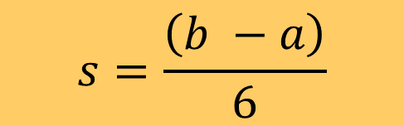
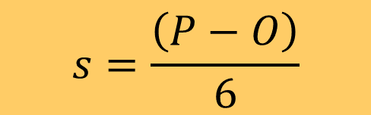
Standard Deviation When Using O, M, P
Frequently we don’t have data on Cost or Duration, and so we use 3 estimation points, O, M, P
Most likely (m) or M
Most pessimistic (b) sometimes “P”
Most optimistic (a) sometimes “O”
Simplified formula for Standard Deviation S
$$s=\frac{\left(b −a\right)}{6}$$
$$s=\frac{\left(P−O\right)}{6}$$
Source: https://en.wikipedia.org/wiki/Standard_deviation
O
P
6 standard deviations
Notes:
Whenever we are performing tasks we’ve never done before or we’re doing them using a different approach – we wouldn’t have historical information.
But we can find the best experts and come up with a Mostly Likely estimate (M), an Optimistic estimate (O), and a Pessimistic estimate (P).

Slide 52
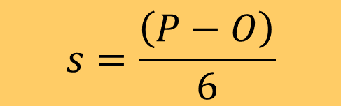
Variances When Using O, M, P
Variance is simply the square of a Standard Deviation (S)
Simplified formula for Variance, take the simplified standard deviation and square it
Variance = S²
We’ll need to use Variances when we determine the standard deviation of a path in a network diagram
$$s=\frac{\left(P−O\right)}{6}$$
Notes:
Whenever we are performing tasks we’ve never done before or we’re doing them using a different approach – we wouldn’t have historical information.
But we can find the best experts and come up with a Mostly Likely estimate (M), an Optimistic estimate (O), and a Pessimistic estimate (P).

Slide 53
Summary of Module
Understand how planning cost management provides guidance for managing costs throughout the project
Understand various cost classifications
Work with Fully Loaded Labour costs and overhead
Work with unit costs and breakeven points
Work with 3-point estimates, PERT, and Statistical Cost Estimation including probabilities

Slide 54
Homework
Refer to the Start Here section of this module
Read for next module:
Kerzner 12th Ed 474, 478, 484-486, 11th p 701, 706, 714-718
PMBOK 6th Ed .7.2
Review PPT files with solutions
Assignments, practice quizzes and graded quizzes, check the Course at a Glance and FOL/Content/Course Assignments & FOL/Evaluations/Quizzes

Slide 55

Copyright © 2013 Pearson Education, Inc. Publishing as Prentice Hall

